Slide 1
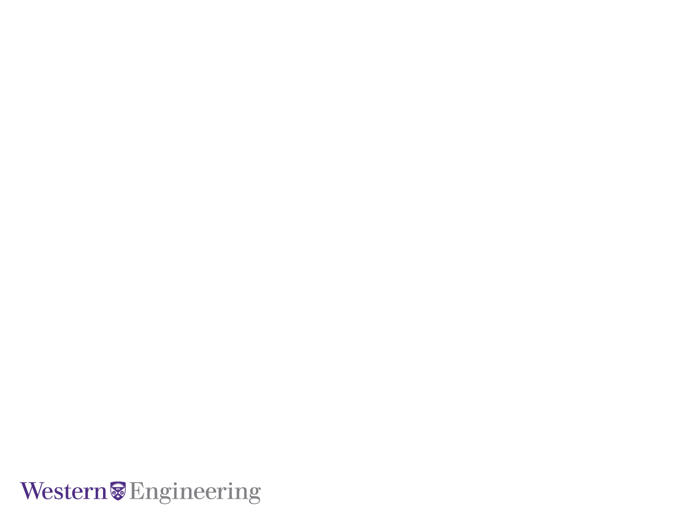
Penetration Testing using Burp Suite
Presented By
Navjot Kaur and Tanushree Das
Electrical and Computer Engineering

Slide 2
Contents :
Web Application Security
Burp Suite
Experiment
Project Deliverables
WAPT

Slide 3
Important Terms
Threat: any potential occurrence, malicious or otherwise, that could harm an asset
Vulnerabilities: a weakness that makes a threat possible. Weak input validation is an example of an application layer vulnerability
Attacks: An action that exploits a vulnerability or enacts a threat. For e.g. DOS attack

Slide 4
Web Application Security:
Web Application are client-server software application, which the client runs in a web browser.
Security holes in the web application layer can make a perfectly patched and firewalled server completely vulnerable.
Web Application are loaded with lot of vulnerabilities which can be misused by a hacker to:
Insert Spam links to perform URL Redirection.
Malicious Code insertion on client computer.
Access and retrieve information from database and session IDs.
Get information about user’s browsing habits.
WAPT

Slide 5
Application Threats and Countermeasures
Input validation: Buffer overflow; cross-site scripting; SQL injection; normalization
Authentication: Network eavesdropping; brute force attacks; dictionary attacks; cookie replay; credential theft
Authorization :Elevation of privilege; disclosure of confidential data; data tampering; luring attacks
Cryptography: Poor key generation or key management; weak or custom encryption

Slide 6
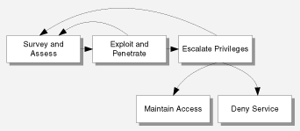
Attack Methodology

Slide 7
Some of the famous bugs
Injection like Sql and Os
Broken Authentication And Session Management
XSS – Cross Site Scripting
Insecure Direct Object Reference
Security Misconfiguration
Sensitive Data Exposure
Missing Function level Access Control
CSRF -Cross Site Request Forgery
Using Components with Known Vulnerabilities
Unvalidated Redirects and Forwards

Slide 8
Burp Suite: A penetration testing tool
Identify weaknesses in web applications, web servers and associated databases
Used for viewing and intercepting the data that passes between the user’s browser and the website being visited.
checking for potentially dangerous transmissions and denying them before they can do harm.
Used to uncover ways malicious users may try to force invalid data onto the website
Giving you time to modify your Web applications for greater security.
WAPT

Slide 9
Key Components of burp suite
Intercepting proxy: To inspect and modify traffic between browser and the target application.
Application-aware Spider: For crawling content and functionality.
Web application Scanner : For automating the detection of numerous types of vulnerability.
Intruder Tool: For performing powerful customized attacks to find and exploit unusual vulnerabilities.
Repeater tool: For manipulating and resending individual requests.
Sequencer tool : For testing the randomness of session tokens.

Slide 10

Experiment :
Using Burp Suite as a Proxy to intercept HTTP traffic
WAPT

Slide 11
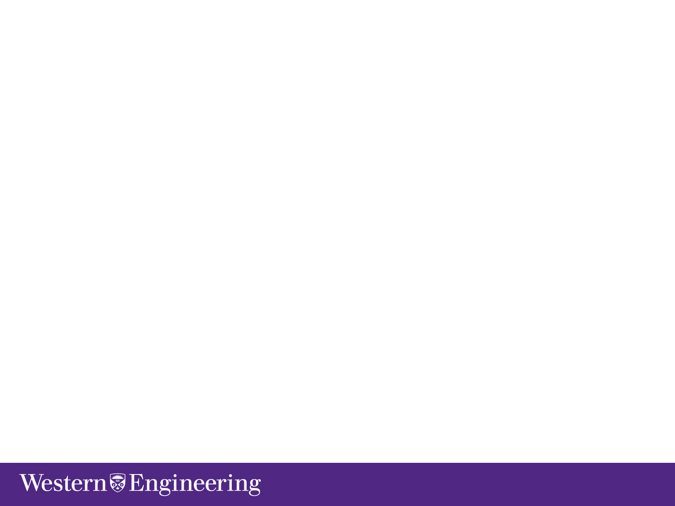
Requirements :
Java 1.7 and above , we are using Java 1.8
Burp Suite jar file, we are using Burp Suite Free Edition(v 1.6.32).
Damn Vulnerability Web App(DVWA), XAMPP(Cross-platform web server solution stack).
WAPT

Slide 12
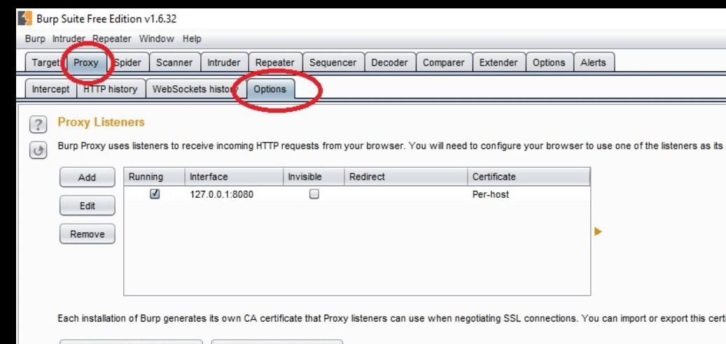
Burp Suite:
Start the Burp Suite and check if ‘Proxy’ is running.
To check go to the ‘Options’ .
WAPT

Slide 13
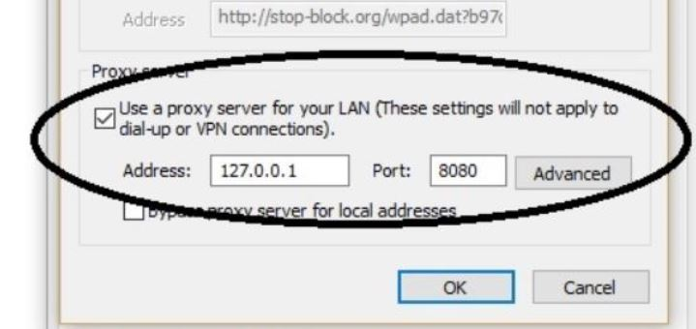
Proxy Setting(Chrome):
Advanced Settings->Network->Change Proxy Setting->LAN Settings->Proxy server
WAPT

Slide 14
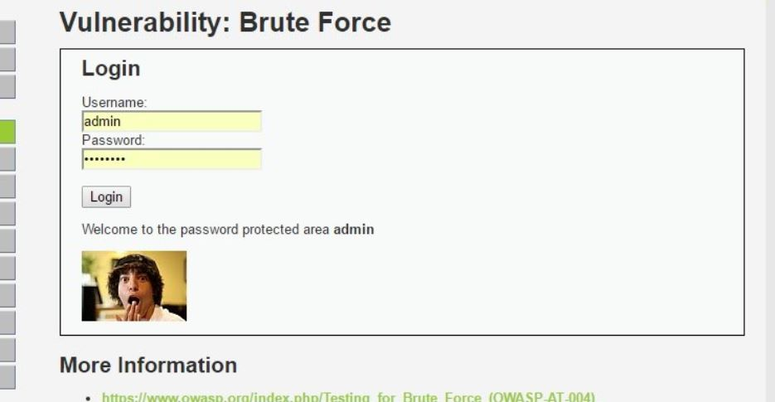
DVWA(Brute Force):
Enter the Username and Password and Click on Login
WAPT

Slide 15
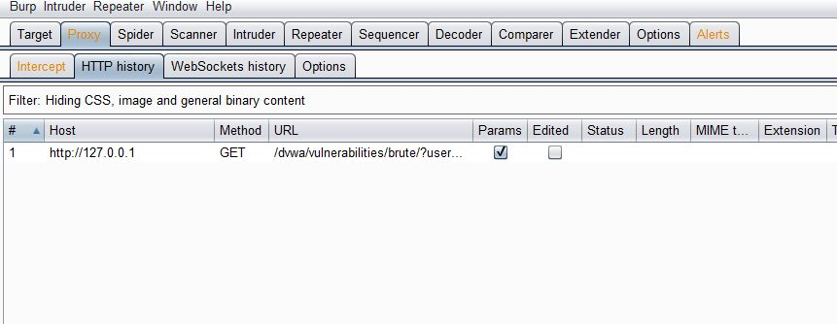
Burp Suite:
To check the Intercepted packets go to ‘HTTP history’ under ‘Proxy’
GeoCAPTCHA

Slide 16
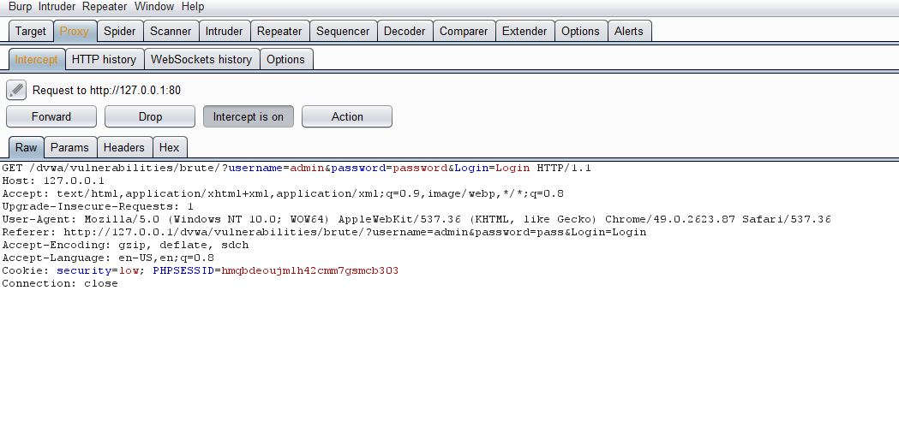
Burp Suite(Intercept):
On clicking the options displayed under list we can see the intercepted request.
WAPT

Slide 17
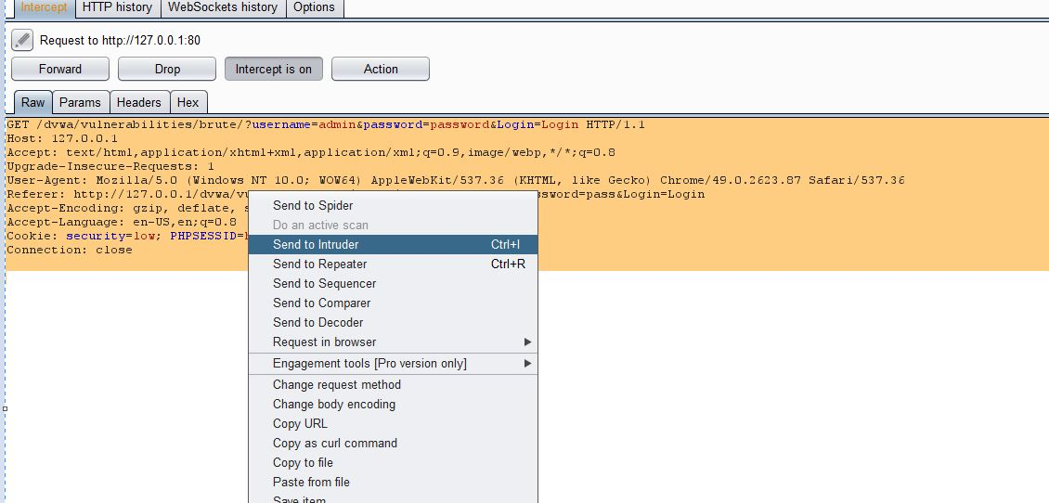
Burp Suite(Intruder):
Right Click and send to Intruder
WAPT

Slide 18
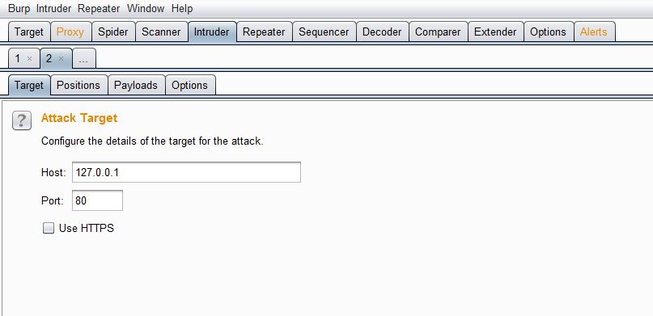
Burp Suite(Intruder):
Target Details
WAPT

Slide 19
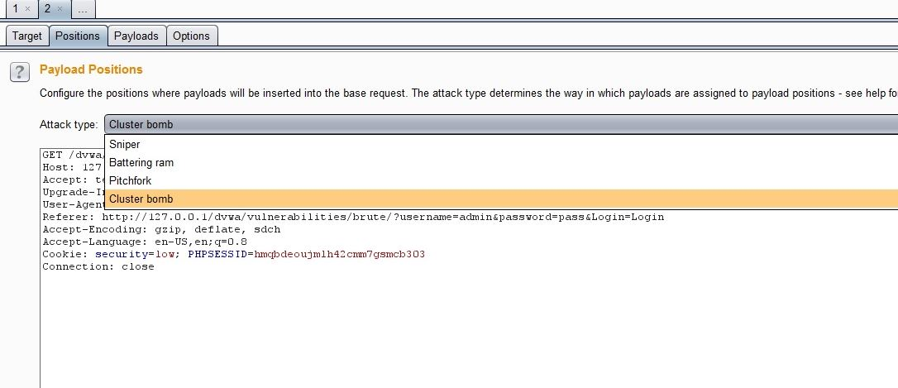
Burp Suite(Intruder):
Select Attack Type: Cluster Bomb
WAPT

Slide 20
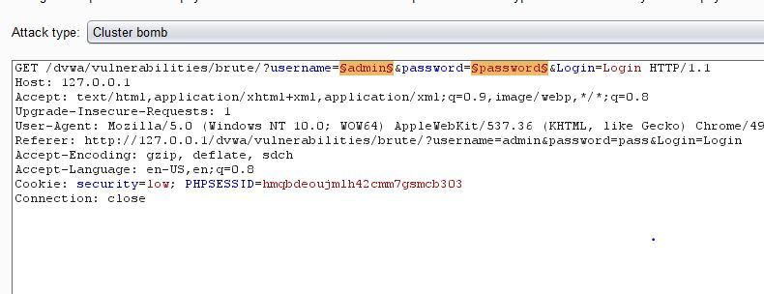
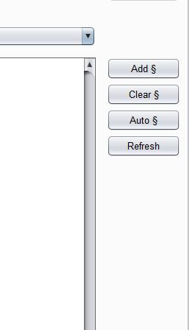
Burp Suite(Intruder):
Add and Clear Payloads.
WAPT

Slide 21
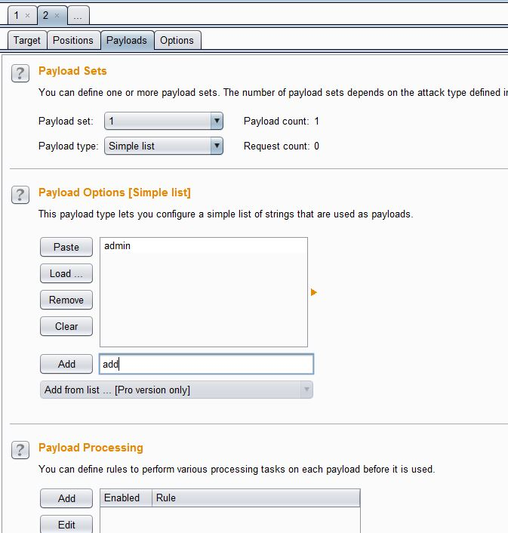
Burp Suite(Intruder):
Add the list of User and password to Payload
WAPT

Slide 22
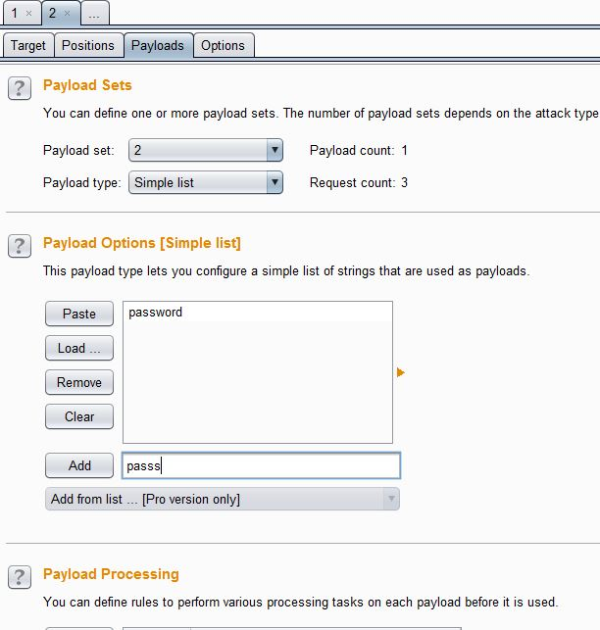
Burp Suite(Intruder):
Add the list of User and password to Payload
WAPT

Slide 23
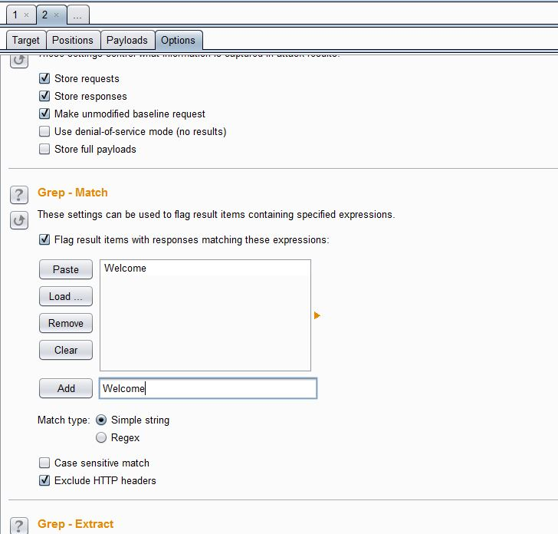
Burp Suite(Intruder):
. Grep Match : To identify that the Payload data is valid
WAPT

Slide 24
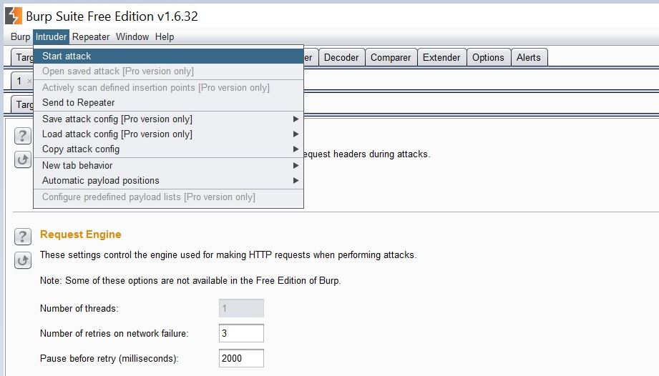
Burp Suite(Intruder):
Select Intruder->Start Attack.
WAPT

Slide 25
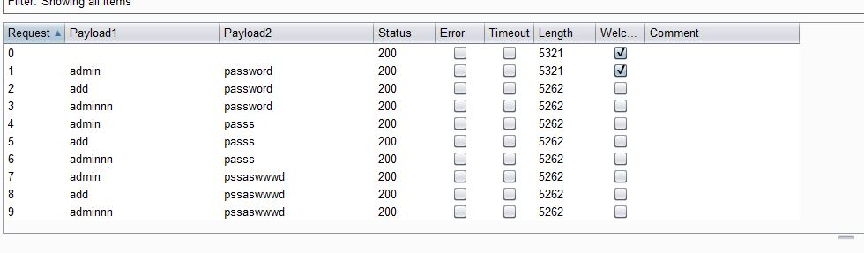
Burp Suite(Intruder):
Brute Force Attack Simulation
WAPT

Slide 26
Deliverables:
In this Project, we are undertaking Penetration Testing to learn about security aspects of Web Applications.
Intercept and analyze HTTP/HTTPS traffic between the client and the website.
Modify the traffic (Man in the Middle attack) and send it to Server to point out vulnerabilities present, through Burp Suite Proxy.
Test and detect SQL Injection and cross-site scripting through Burp Suite Intruder.
Send malicious HTTP request to web server and analyze the responses using Burp Suite Repeater.
WAPT

Slide 27
References :
Web Application Security, http://www.applicure.com/solutions/web-application-security
Burp Suite Information, https://portswigger.net/burp/
Using Burp Suite proxy tool to examine client side requests, http://www.computerweekly.com/tip/Using-Burp-Suite-tool-to-examine-client-side-requests
Web application , Wikipedia, https://en.wikipedia.org/wiki/Web_application
WAPT

Slide 28
References :
Burp Suite ,Wikipedia, https://en.wikipedia.org/wiki/Burp_suite
Burp Suite Information, https://portswigger.net/burp/
Using Burp Suite proxy tool to examine client side requests, http://www.computerweekly.com/tip/Using-Burp-Suite-tool-to-examine-client-side-requests
Web application , Wikipedia, https://en.wikipedia.org/wiki/Web_application
WAPT

Slide 29
THANK YOU
WAPT

